Slide 1
Appreciation of English and American literature
Week 12: Postmodern Poetry

Slide 2
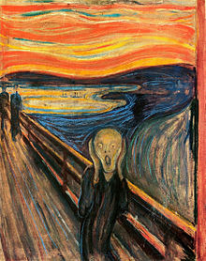
The Scream
1893 – Edvard Munch
Expressionism
A life without foundation –
‘existential angst.’

Slide 3
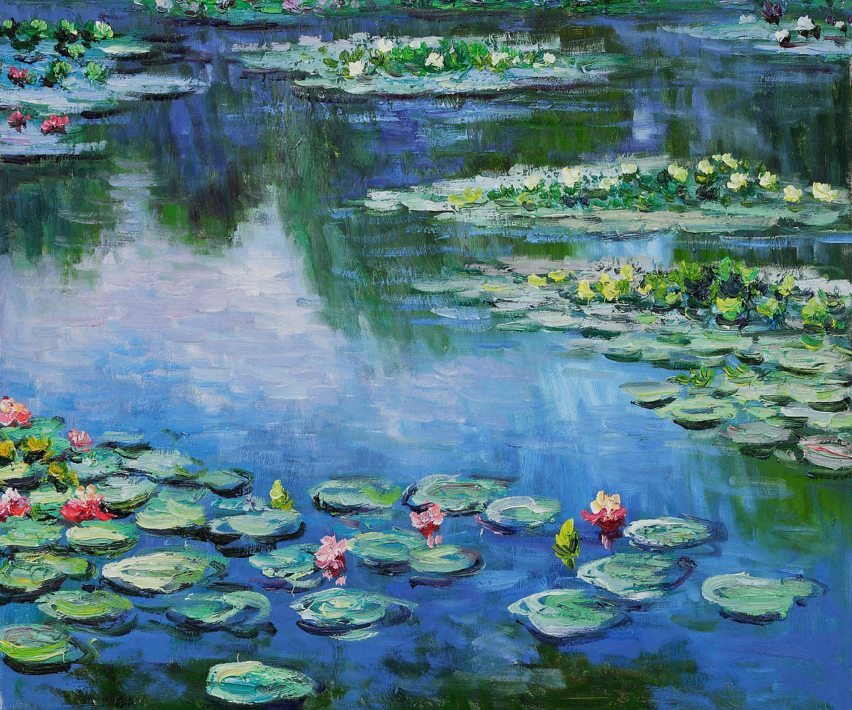
1920 – Claude Monet – Impressionism

Slide 4
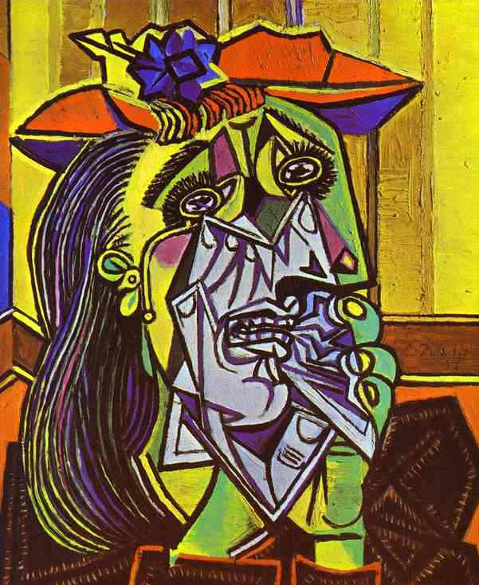
Picasso
1937
Cubism
“It was the deep
reality, not the
superficial one.”

Slide 5

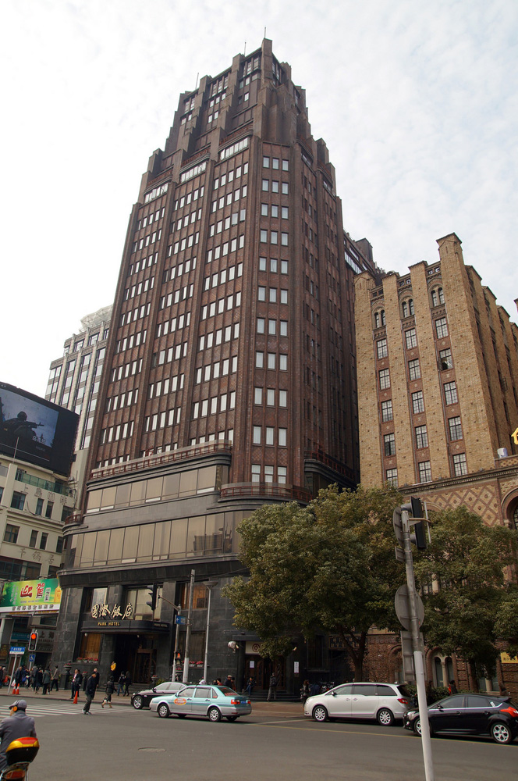
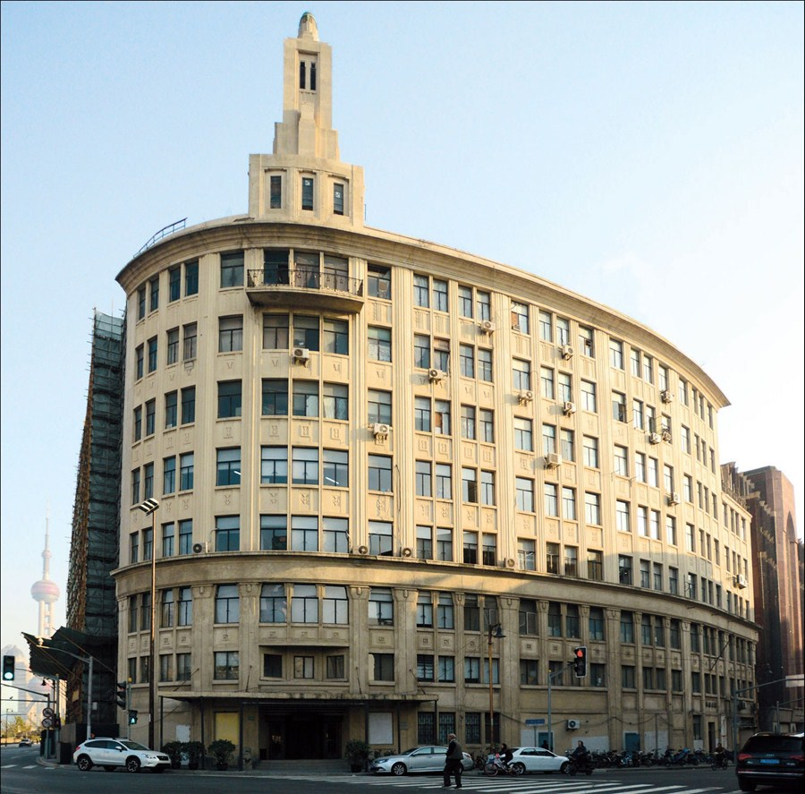
Cubist Architecture (and Art Deco)

Slide 6
Then, after World War II, came Post-modernism and Post-structuralism
After all the war and disaster from modernist ideas, structures and theories, people didn’t trust them any longer. They couldn’t continue with those failed concepts, not exactly as before, and began to subtly change them. But… what to believe in from here…?”
In the 1960s, academics began to question the meaning of a text, of narratives, and of culture (though didn’t question their own interpretations).

Slide 7
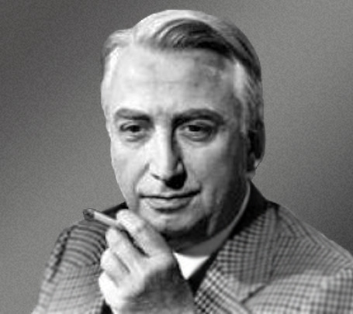
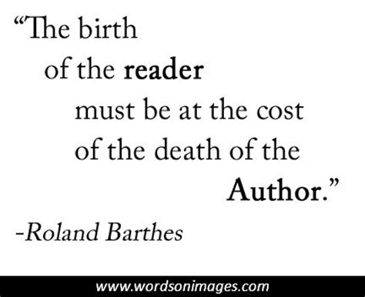
Postmodern Thinkers
Roland Barthes (1915-80) Semiotics, language as signs; overthrowing the author:
He wrote an essay, ‘The Death of the Author,’ about how the meaning the author intended cannot simply be found in the text. He later said the author is a myth, “tyrannical”, keeping the reader prisoner with a certain meaning. This influenced post-structuralism, and ideas of reader ‘reception’ in textual interpretation.

Slide 8

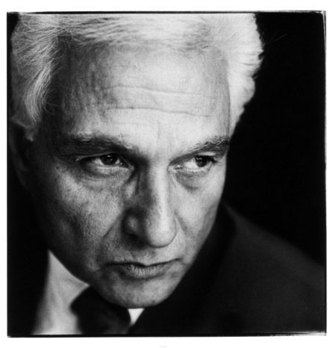

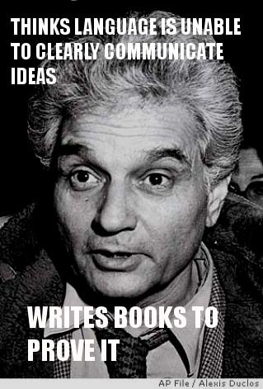
Postmodern Thinkers
Jacques Derrida (1930 – 2004) –Deconstructionism
He said: “There is nothing outside the text.” Derrida thought that words didn’t point to any firm meaning. Yet… then said that the text should be broken down, ‘deconstructed’, to find its meaning – for postmodernists, usually that was ‘power discourse’.
“I have attempted deconstructive criticism in opposition to the authority of meaning… against… the history of meaning.”

Slide 9
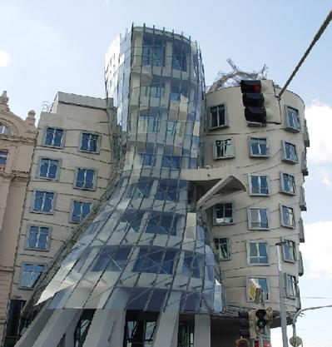
Post-modernism, Post-structuralism

Slide 10
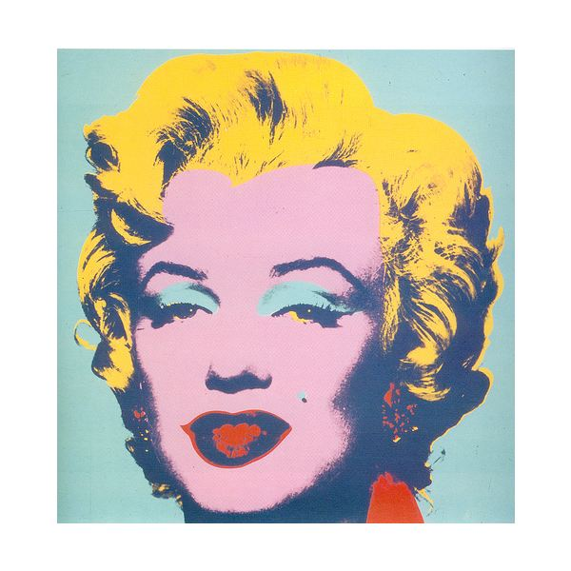
Why make this ‘art’?
Andy Warhol
1962
Marilyn
Diptych

Slide 11
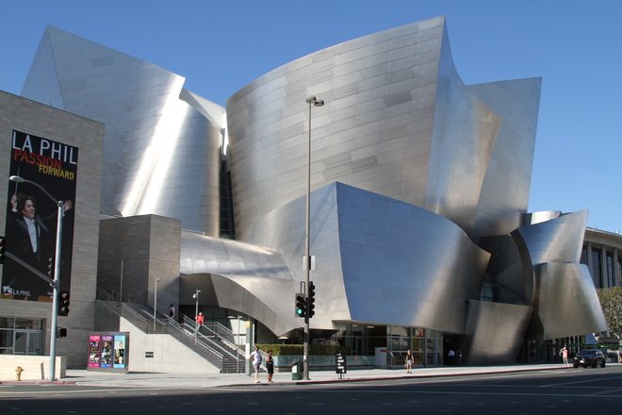
Post-modernism, Post-structuralism

Slide 12

Identify the architecture…

Slide 13

Shanghai’s
Modernist /
Post-modernist
architecture?

Slide 14
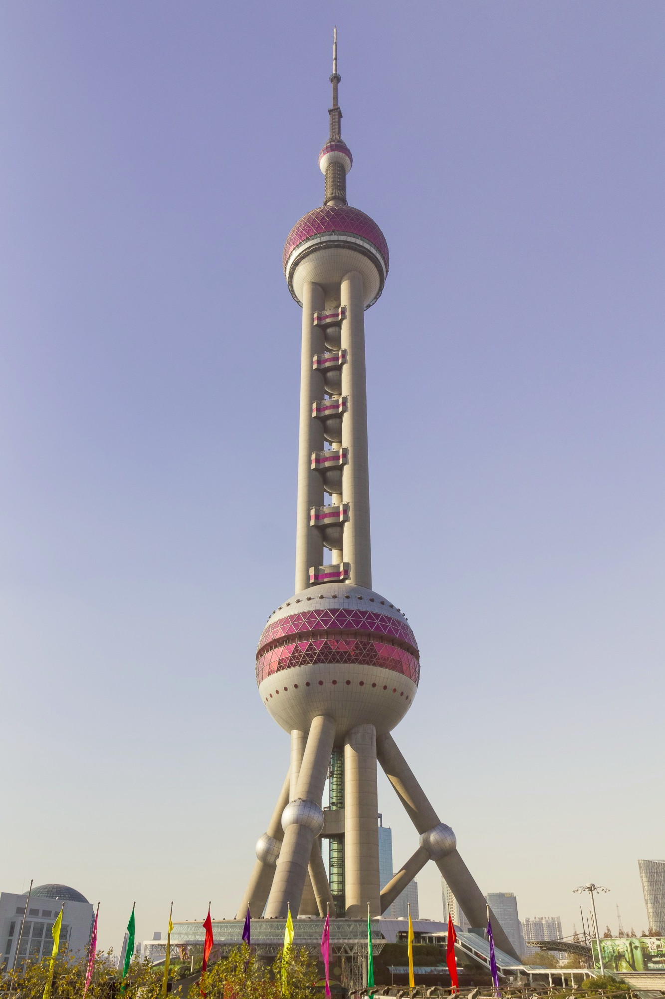
Shanghai’s Modernist architecture?
Structuralism and overt symbolism.

Slide 15
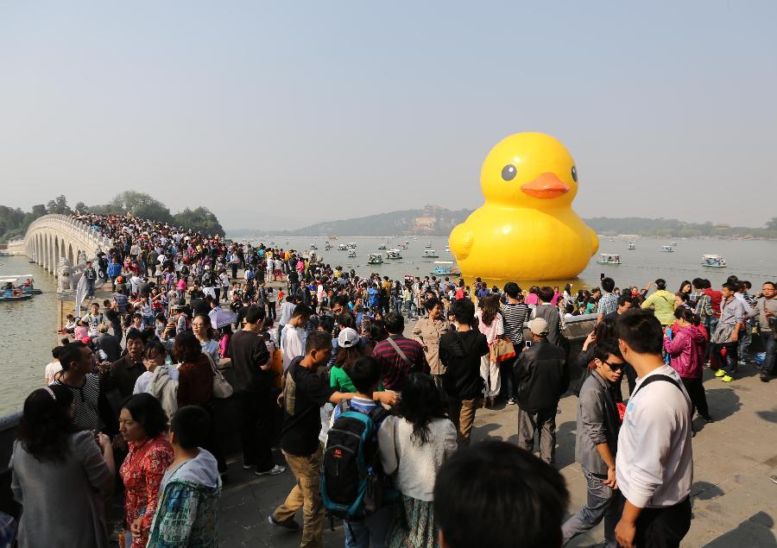
Postmodern culture

Slide 16
Literature, Themes and Ideologies
Modernist texts tend to have clear ideological structures of style and methodology. They may be ‘lost’ in terms of meaning, with a declared aim, such as stream of consciousness, etc.
Postmodernist texts tend to be post-structuralist. There is no longer any pretence at a firm meaning or structure – even the idea of meaning is meaningless. Everything is relativist… and so nothing can be objectively evaluated.
But of course, this lack of foundation still communicates through language.

Slide 17
Postmodern Poetry

Slide 18
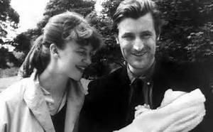
Sylvia Plath (1932-63)
Born in the U.S.A. in Boston.
A famous poet (more so posthumously), who married another famous poet from England, called Ted Hughes.
She wrote ‘confessional’ poetry about
her feelings and personal traumas.
She had depression, and was treated
in her youth with electro-shock therapy.
She is also sadly infamous for her death by
suicide. She put her head into an oven and
gassed herself.

Slide 19
Sylvia Plath poems
What is Morning Song about?
How might it be considered ‘confessional’ poetry?
What poetic techniques does Plath use?
- Can you find ‘enjambment’ – when a sentence or clause continues on to the line below.
What is the poem’s tone and meaning?

Slide 20
Sylvia Plath poems
How does Sylvia Plath describe the scene of the Winter Trees?
What is ‘Ledas’ a reference to?
What is the mood and tone of the poem? What does it mean?

Slide 21
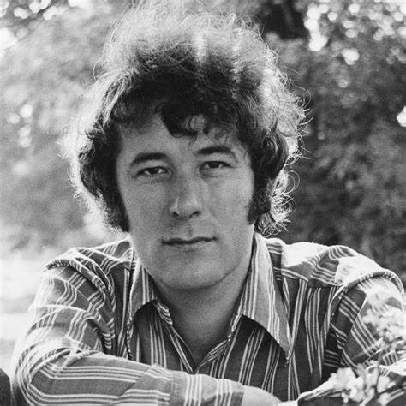
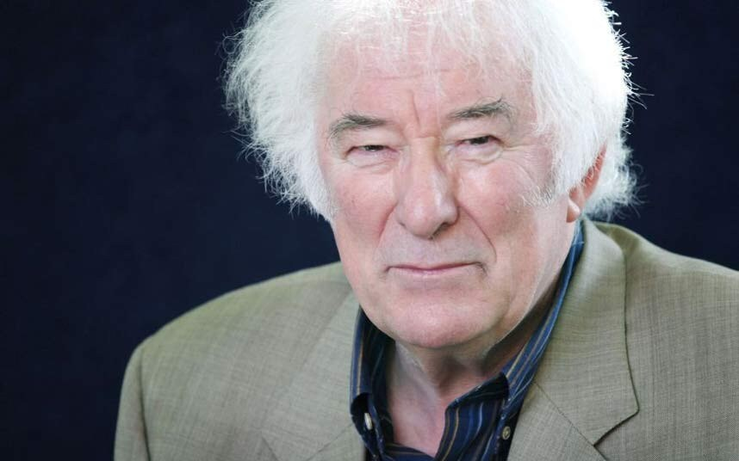
Seamus Heaney (1939-2013)
Born in Northern Ireland, one of nine children – but considered himself Irish.
His father was a cattle farmer.
Became one of Ireland’s most well-known poets.
Translated Beowulf in 1999, which we read.
Some of his poems make reference to ‘the troubles’ in Ireland.
“When a poem rhymes, when a form generates itself, when a metre provokes consciousness into new postures, it is already on the side of life… When language does more than enough, as it does in all achieved poetry, it opts for the condition of overlife, and rebels at limit.”

Slide 22
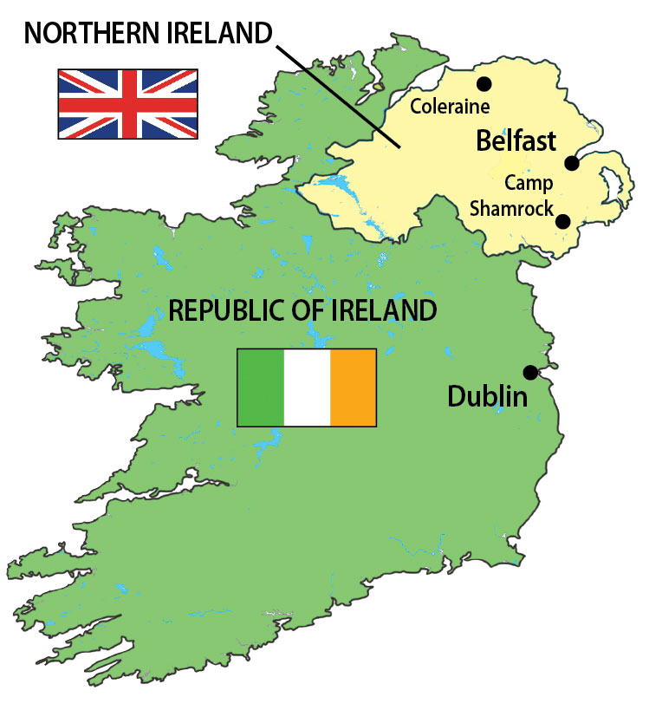
1169 AD – Normans conquer part of Ireland.
16th Century English settlements. King Henry VIII also calls himself ‘King of Ireland’.
19th century – ‘Home Rule’ political campaign
1916 – Easter Uprising against British rule.
1922-37 – Southern ‘Ireland’ becomes a separate republic.
1960s - 1998 – ‘The Troubles’: violence and terrorism in Northern Ireland and Britain.
The Unionists in the north want to be part of the UK. The Republicans in southern Ireland want all of Ireland to be independent from the UK.

Slide 23
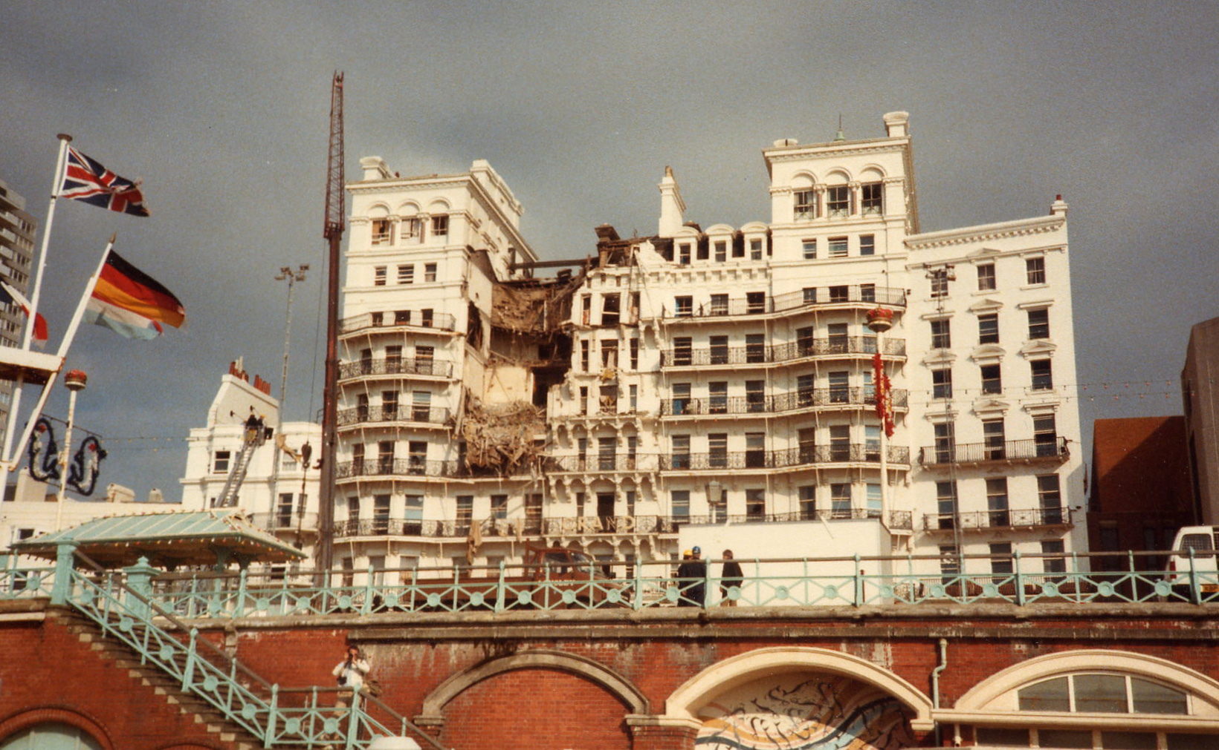
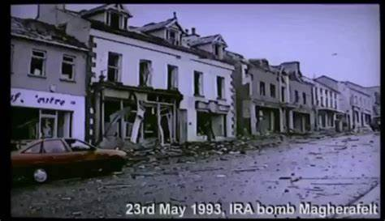
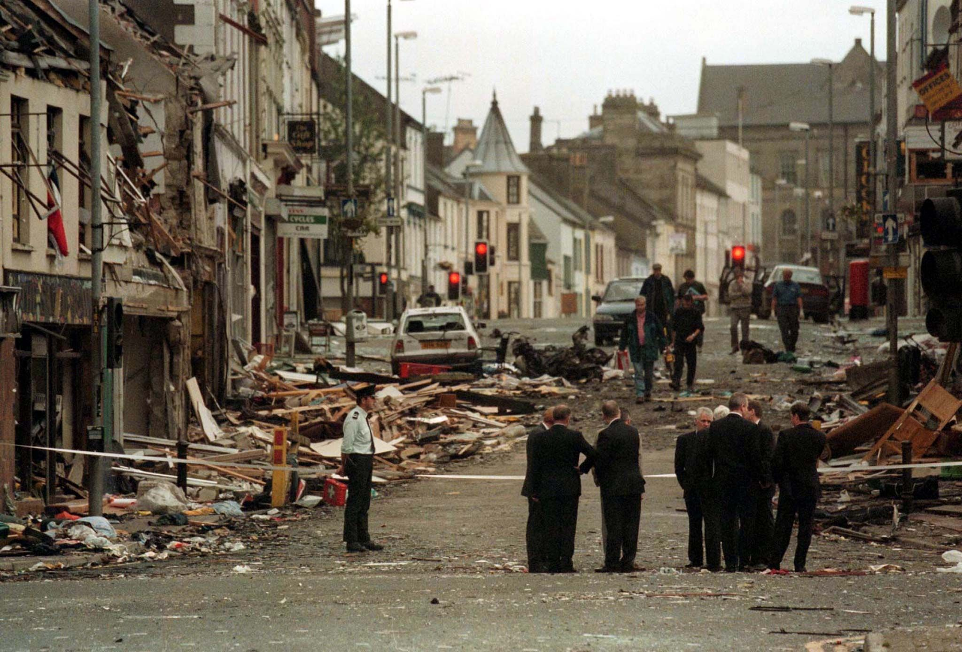
The Grand Brighton Hotel, in 1984
The IRA (Irish Republican Army) planted bombs to attack the British army, police, and civilians in Northern Ireland and the British Mainland, and also the British Government.
The Omagh bombing in Northern Ireland, in 1998, killed 29 people in the town centre – after the public voted for a peace deal.
The Northern Irish town of Magherafelt was attacked by an IRA bomb hidden in a van, in 1993.
Omagh after the bombing in 1998

Slide 24
Seamus Heaney poems: Two Lorries
It's raining on black coal and warm wet ashes. There are tyre-marks in the yard, Agnew's old lorry Has all its cribs down and Agnew the coalman With his Belfast accent's sweet-talking my mother. Would she ever go to a film in Magherafelt? But it's raining and he still has half the load
To deliver farther on. This time the lode Our coal came from was silk-black, so the ashes Will be the silkiest white. The Magherafelt (Via Toomebridge) bus goes by. The half-stripped lorry With its emptied, folded coal-bags moves my mother: The tasty ways of a leather-aproned coalman!
What special structure does this poem have?
Compare the ends of the lines in both stanzas.

Slide 25
Seamus Heaney poems: Two Lorries
It's raining on black coal and warm wet ashes. 1 There are tyre-marks in the yard, Agnew's old lorry 2 Has all its cribs down and Agnew the coalman 3 With his Belfast accent's sweet-talking my mother. 4 Would she ever go to a film in Magherafelt? 5 But it's raining and he still has half the load 6
To deliver farther on. This time the lode 6 Our coal came from was silk-black, so the ashes 1 Will be the silkiest white. The Magherafelt 5 (Via Toomebridge) bus goes by. The half-stripped lorry 2 With its emptied, folded coal-bags moves my mother: 4 The tasty ways of a leather-aproned coalman! 3
What special structure does this poem have?
Compare the ends of the lines in both stanzas.

Slide 26
Seamus Heaney poems: Two Lorries
This poem is a sestina
Six stanzas
Six lines per stanza
Then a three line final ‘envoi’ = a short concluding stanza
This form was invented about 1200 AD in France by Arnaut Daniel. English sestinas were only written centuries later.
They’re often in iambic pentameter (but Heaney uses ‘free verse’).
Later sestinas include homophone endings to lines: ‘load’ and ‘lode’.

Slide 27
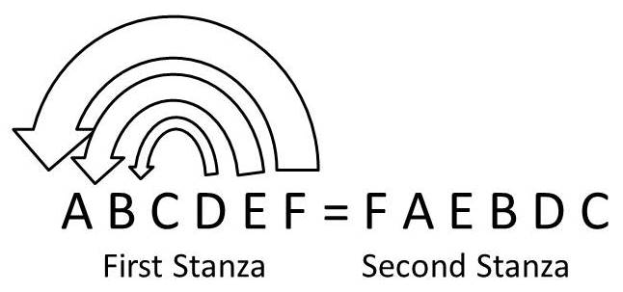
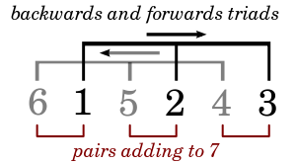
What is the effect of using this pattern of words and lines?

Slide 28
Seamus Heaney poems: Two Lorries
What happens in the first half of the poem? What changes in the second half?
What is the mood and tone of the poem?
What links does the poet draw between past and present?

Slide 29
Seamus Heaney poems: Follower
Based in iambic tetrameter: unstress-Stress, but also varies.
Who is following whom?
What is the metre (syllable pattern) and rhyme?
A B A B: some rhymes are ‘perfect’ / ‘full’ and some are ‘slanting’ / ‘half’ / ‘near’.

Slide 30
Seamus Heaney poems: Follower
My father worked with a horse-plough, His shoulders globed like a full sail strung

Slide 31
Seamus Heaney poems: Follower
My father worked with a horse-plough, His shoulders globed like a full sail strung

Slide 32
Seamus Heaney poems: Follower
My fa / ther worked / with a / horse-plough, His shoul / ders globed / like a full / sail strung
Iamb = unstress-Stress Trochee = Stress-unstress
Pyrrhic = unstress-unstress Spondee = Stress-Stress
Anapest = unstress-unstress-Stress Dactyl = Stress-unstress-unstress

Slide 33
Seamus Heaney poems: Follower
What changes happen to the metre in the last stanza? Why?
I was a nuisance, tripping, falling, Yapping always. But today It is my father who keeps stumbling Behind me, and will not go away.

Slide 34
Seamus Heaney poems: Follower
What changes happen to the metre in the last stanza? Why?
I was a nuisance, tripping, falling, Yapping always. But today It is my father who keeps stumbling Behind me, and will not go away.

Slide 35
Seamus Heaney poems: Follower
Trochees
What changes happen to the metre in the last stanza? Why?
I was a / nuisance, / tripping, / falling, Yapping / always. / But today It is / my fa / ther who / keeps stumbling Behind me, / and will / not go / away.
Antibacchius (Greek term)
Some lines are better described as ‘free verse’.
Dactyl
Pyrrhic

Slide 36
Seamus Heaney poems: Follower
How does young (and old) Seamus feel about his dad?
What feeling is expressed about the passage of time?

Slide 37
Homework Reading
Please read the short excerpts from postmodern novels.
Also, take a look at the article, which gives advice about having a clear and focused thesis for your essay writing.

